Slide 1
Virtual Art Gallery
Case Study Project
J . Vijaya Harcini

Slide 2

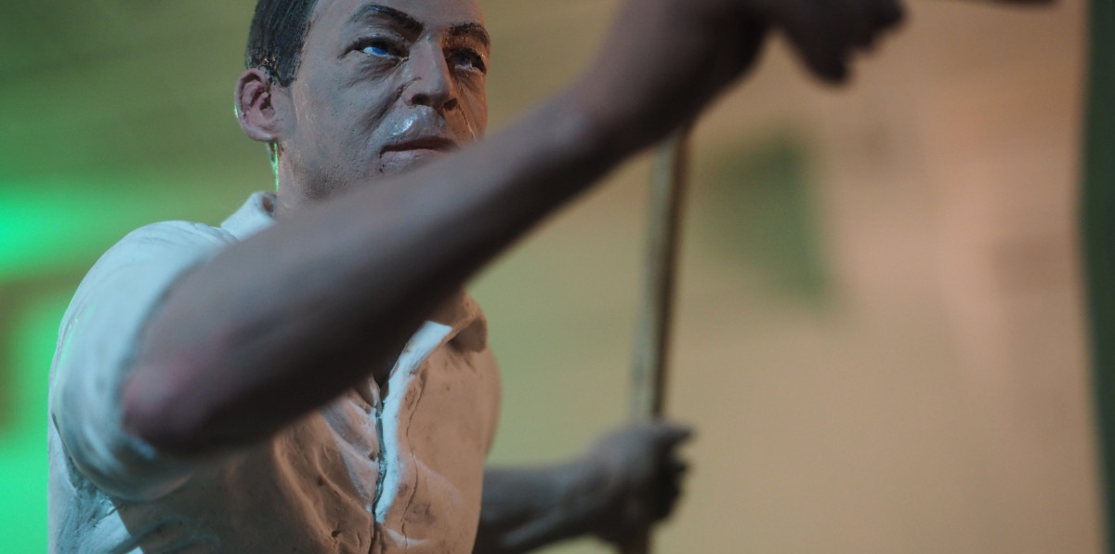

INTRODUCTION
The Virtual Art Gallery is a backend-driven Python + MySQL application.
It provides a structured platform for managing
User interactions (favorites, search)
Gallery curation and viewing
Artists and their artworks
Built using OOP principles and DAO architecture to ensure code modularity.
Supports CRUD operations, robust error handling, and unit testing.

Slide 3




PROBLEM STATEMENT Traditional art galleries have limited accessibility due to geographical, financial, and logistical constraints. Emerging artists often lack platforms to exhibit their work to a broad audience, while art enthusiasts have minimal digital access to discover, view, and curate artworks.
There is a need for a digital solution that bridges this gap by allowing artists to display their works online and enabling users to explore, search, and manage favorite collections seamlessly.

Slide 4



OBJECTIVE
The goal is to develop a Virtual Art Gallery System that enables artists to showcase their work and allows users to interact with the gallery by exploring, searching, and favoriting artworks. The system incorporates a structured backend, OOP, database connectivity, and testing support.

Slide 5


TECHNOLOGY STACK
Programming Language: Python 3.10+
Database: MySQL
IDE: VS Code
Libraries: mysql-connector-python, unittest

Slide 6
KEY FEATURES
Add / View / Update / Delete Artists & Artworks
Manage Galleries and assign Curators
Add / View / Remove User Favorites
Search artworks and galleries using keywords
Unit testing for system validation

Slide 7
ARCHITECTURE & OOP
Encapsulation: Entity classes for structured data
Abstraction: DAO Interface (IVirtualArtGallery)
Inheritance: Custom exception classes
DAO Pattern: Separation of logic and database code

Slide 8
DATABASE SCHEMA
Tables:
Artist
Artwork (FK: ArtistID)
User
Gallery (FK: CuratorID)
Favorite Artworks (FK: UserID, ArtworkID)
Relationships clearly defined using Primary and Foreign Keys

Slide 9
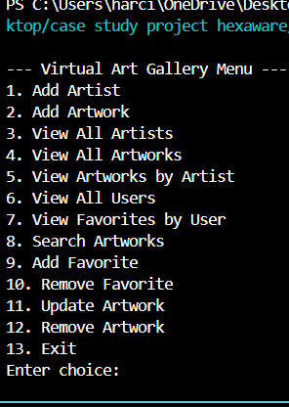
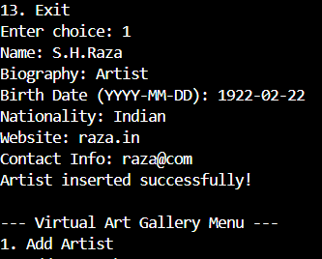
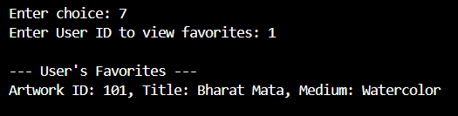
SAMPLE SCREENSHOTS
CLI Menu UI
Added Successfully
View Favorites Output

Slide 10
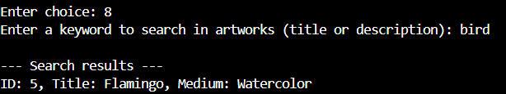
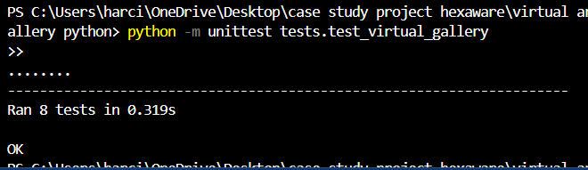
SAMPLE SCREENSHOTS
Search Results
Unit Test Passed Output

Slide 11
UNIT TESTING SUMMARY
Total Test Cases: 8
Tools Used: unittest (PyUnit)
Modules Tested:
Artwork: Add, Update, Delete, Search
Gallery: Add, Update, Delete, Search

Slide 12


CONCLUSION
Fully functional CLI-based backend gallery system
Follows OOP and DAO patterns
Robust database integration with MySQL
Successfully tested using unittest framework
Ready for deployment or web integration in future

Slide 13

Thank you

